Slide 1
PSY100
Attention & Memory (Ch. 7)
Thinking & Intelligence (Ch. 8)

Slide 2
Attention
Attention is the ability to focus on important or relevant information
Attention is a limit resource.

Slide 3

Attention
Attention is the ability to focus on important or relevant information
Attention is a limit resource.

Slide 4
Attention
Attention is the ability to focus on important or relevant information
Attention is a limit resource.
Change blindness: we are often blind to large changes in the environment because we cannot attend to all of the visual information that is available.

Slide 5
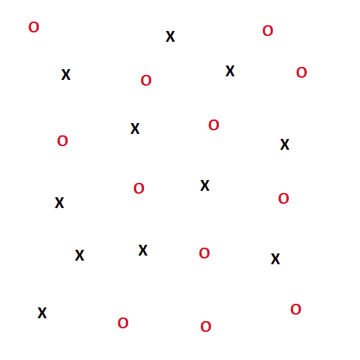
Attention – Visual Search
How many ‘O’s are in this picture?

Slide 6
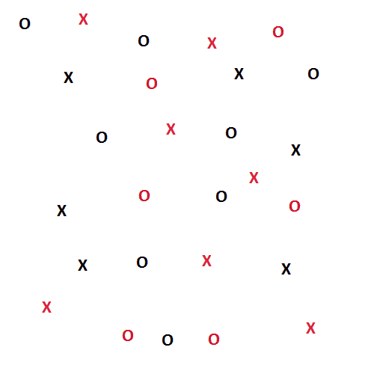
Attention – Visual Search
How many red ‘X’s are in this picture?

Slide 7
Parallel vs. serial processing
Parallel processing: features like color, shape, orientation and motion “pop out” – it is easy to find targets when relying on one feature.
When we need to use attention to search for two features , we process information more slowly, serially (one at a time) and with more effort.

Slide 8
Memory Processes
Encoding – processing of information so it can be stored
Storage – retention of encoded representations over time
Retrieval – recalling stored information

Slide 9
Modal Memory Model
Proposed by Atkinson & Shiffrin (1968)
Sensory Memory
Short-Term Memory
Long-Term Memory
Sensory Input
Rehearsal
Encoding
Attention
Retrieval

Slide 10
Sensory Memory
“Trace” of sensory input
Lasts only a fraction of a second
Very large capacity
George Sperling (1960):
Shown for just 1/20th of a second!
Participants could recall any one row
(but not the others)
Ability goes away as delay increases
G T F B
Q Z C R
K P S N

Slide 11
Short-Term Memory (Working Memory)
Lasts 20-30s without rehearsal
Capacity of 7 ± 2 items
Can increase capacity by chunking
12071941 – hard to remember
12/07/1941 – easier to remember
Phonological Loop
Rehearsal
Visuospatial Sketchpad
Central Executive
Long-Term Memory
Episodic Buffer
Baddeley’s Model of Working Memory

Slide 12
Long-Term Memory (LTM)
Permanent memory storage
Lasts a lifetime
Very large capacity
Long-term Memory
Declarative Memory
Implicit Memory
Episodic
Semantic
Procedural
Classical
Priming
Memory
Memory
Memory
Conditioning
Easier to remember recent/related items
Personal Experiences
“Muscle”
Memory
Pavlov’s Dogs
Facts

Slide 13
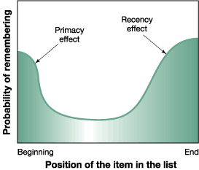
Serial Position Effect
When asked to remember a list of words:
Due to long-term memory
Due to working memory

Slide 14
Levels of Processing Model
According to this model by Craik & Lockhart, items are better remembered if they are deeply encoded.
Semantic encoding: focus on meaning of words
Acoustic encoding: focus on sound of words
Visual encoding: focus on shape of words
More items remembered
This is why elaborative rehearsal (thinking about something conceptually) is better than maintenance rehearsal (just repeating it over and over)

Slide 15
Encoding Specificity Principle
Retrieval cue: anything that helps us find information in LTM
This is why multiple choice (recognition) is easier than essay questions (recall)
According to Endel Tulving, any stimulus encoded with an experience can be a retrieval cue.
Context-dependent memory – better memory when external environment is the same during encoding and retrieval
State-dependent memory – better memory when internal state is the same during encoding and retrieval

Slide 16
Hippocampus & Consolidation
Damage to the medial temporal lobes (as in HM) causes anterograde amnesia – the inability to store new declarative memory
The hippocampus is believed to be important for consolidation (transfer from WM to LTM)
Memory storage thought to be in perceptual areas; connections strengthened via consolidation
Reconsolidation occurs after memories are retrieved into working memory

Slide 17
Spatial Memory
Hippocampus also involved in spatial memory:
Rats with hippocampus lesions impaired at Morris water maze task (rat must find hidden platform in a pool)
Place cells in the hippocampus fire only at specific locations
London taxi drivers have larger hippocampi

Slide 18
Frontal Lobes & Amygdala
Frontal lobes are involved in encoding
Deep encoding = more activity
More activity when encoding words later remembered vs. later forgotten
Frontal lobes involved in working memory
Monkeys with frontal lesions have trouble with delayed recall
Fear causes activity in the amygdala – associated with better memory
Flashbulb memory – vivid memories of a particularly emotional event (eg. 9/11)

Slide 19
Forgetting
Early theories argued delay (time) causes forgetting
Ebbinghaus learned nonsense syllables: found that forgetting happened quickly in first few days, but soon leveled off.
Also found “savings” – easier to relearn
Interference from other information now thought to cause forgetting
Proactive interference – old information blocks encoding of new information
Retroactive interference – new information blocks retrieval of old information
Blocking (retrieval difficulties for uncommon items) occurs due to interference from more common items
Absentmindedness is caused by inattention and/or shallow encoding

Slide 20
Amnesia
Amnesia is a deficit in long-term memory, usually caused by brain injury, disease or psychological trauma
Retrograde amnesia – cannot retrieve memories from LTM, forget past events
Anterograde amnesia – cannot consolidate new memories into LTM (like HM)

Slide 21
Memory Distortions
Memory is reconstructive! We recall details based on consistency, not truth
Source misattribution/amnesia: misidentify or forget where we learned something
Changes how much we believe it
People’s memories can be changed
Loftus & Palmer showed people a car crash and got people to add consistent but untrue details by framing the questions
They even got kids to “remember” false memories by having an older relative suggest it
Confabulation: “honest lying” – remembering untrue details (which are consistent with each other) due to brain injury.
Capgras syndrome – think family are imposters

Slide 22
Chapter 8: Thinking and Intelligence
How does the mind represent information?
Analogical representations
Symbolic representations.

Slide 23
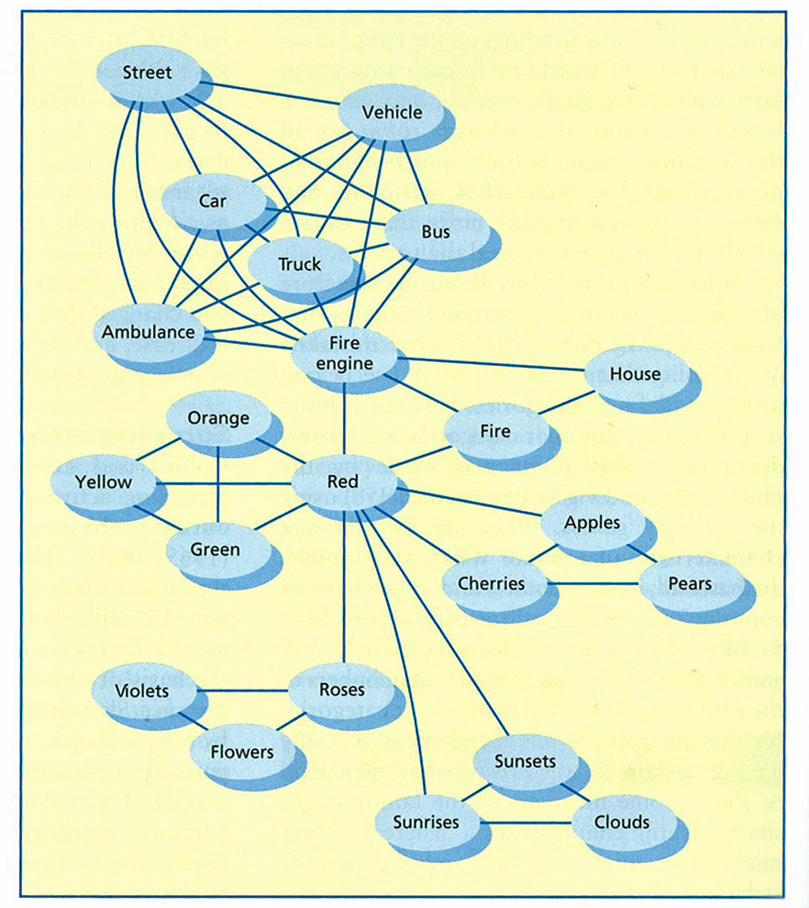
Spreading Activation Model
Concepts arranged as nodes.
Activation of one node “spreads” to connected nodes

Slide 24
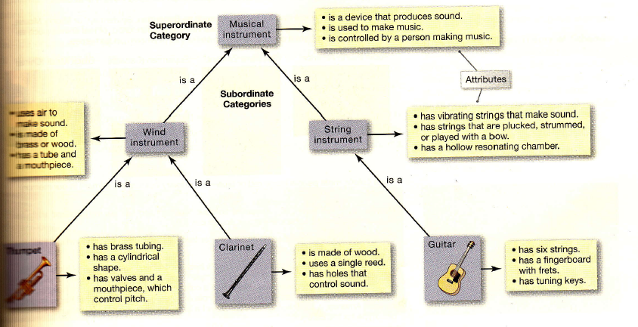
Defining Attribute Model
How do we organize knowledge?
This model is like taxonomy

Slide 25
Prototypes/Examplars
Prototype model
We have a prototype (best example of category)
We classify new items based on how much they resemble our prototypes
Examplar model
All members of category are “examplars”
We classify new items based on how much they share in common with examplars

Slide 26
Schemas & Scripts
Schemas are mental frameworks for understanding the world
Scripts are schemas about sequences of events (eg. going to the library)
These are useful abstractions, but can lead to stereotyping

Slide 27
Deductive/Inductive Reasoning
Deductive reasoning: use logic to determine if something is true given certain premises (always true if premises are correct)
Cats that purr are happy
This cat is purring
Therefore this cat is happy
Inductive reasoning: infer general principles from specific (may not be true)
These three cats are purring and happy
Infer: Happy cats purr

Slide 28
Heuristics
Heuristics – mental shortcuts for decision making (save time/effort, but less accuracy)
Availability heuristic – judging how common something is based on how easy it is to recall
Representativeness heuristic – categorizing based on similarity to prototypes
This can lead to ignoring the base-rate (how common something is)

Slide 29
Prospect Theory
Developed by Kahneman & Tversky
Describes how people make choices in probabilistic situations
Evaluation of loss/gain dependent on some reference point
Bill Gates would take a $1M coin flip bet
People are loss-adverse
Also applies to emotions!

Slide 30
Problem Solving
Insight – sudden realization of solution
Functional fixedness – the idea that something has only a particular function
Mental sets – previously successful strategy that may block new thinking
Some common strategies: subgoals, working backwards, using an analogy…
Paradox of choice – having more options makes people less happy (more effort spent in choosing)
Satisficers and maximizers

